Slide 1
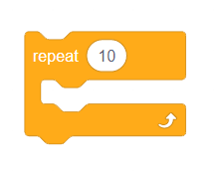
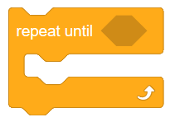
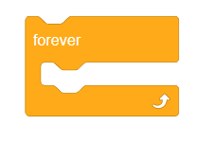
Scratch Block Choice Board
Hide character
When this sprite clicked
Change size
Repeat X number of times
Change color
Repeat until
When any key pressed
Repeat forever
Show character

