Slide 1
Sequence the sheep’s path to grass!
Unplugged Puzzles

Slide 2
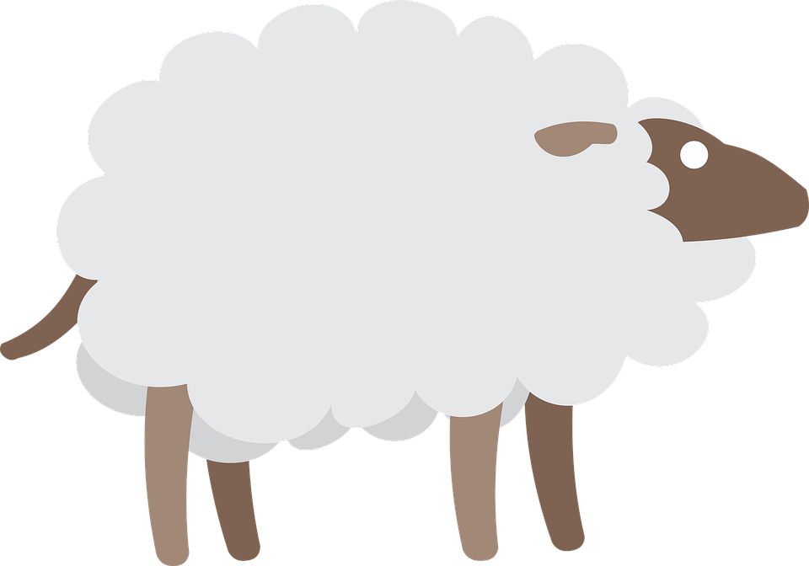
Put the blocks in the correct order to help the sheep find the grass.
1
90
90
Each square equals to a single step
Drag the blocks from the middle column to the right column to solve the puzzle.
1
1

Slide 3
Put the blocks in the correct order to help the sheep find the grass.
1
1
90
1
90
Drag the blocks from the middle column to the right column to solve the puzzle (Only use the provided blocks).
1
There is an extra block that is not needed in the solution.

Slide 4
Put the blocks in the correct order to help the sheep find the grass.
1
1
90
1
1
90
Drag the blocks from the middle column to the right column to solve the puzzle.
90

Slide 5
Now it is your turn to create puzzles and ask your friends to solve them based on the challenges you provided.
1
90
90
1
1

